Slide 1
Xbee-Digimesh network
Presented By:
PRIYANSHU AJMERA
09/07/2018

Slide 2
OUTLINE
Topologies in XBee
DigiMesh Network Setup
Wireless Data Transmission
XBee and Arduino Communication
DigiMesh Network
Routing

Slide 3
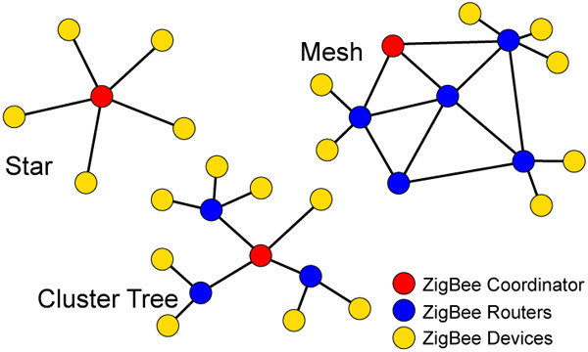
Topologies in XBee
There are in total three topologies:
Star Topology
Tree Topology
Mesh Topology

Slide 4
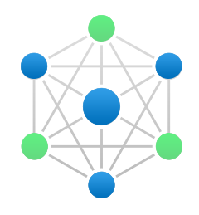
DigiMesh network
A DigiMesh network is a topology in which we can use wireless end-point connectivity solutions. This can help us by providing various benefits such as: Self-healing, Routing, Peer-to-peer architecture, etc.
DigiMesh Network also supports multiple topologies like: Point-to-point, Point-to-multipoint and Mesh networks. Also, all the nodes are capable of Routing the data. Node can be a Coordinator, a Router or an End-Device
Indoor Range of XBee: Up to 2000ft (10kbps) & up to 1000ft (200kbps)
LOS Range of XBee: Up to 9 Miles (10kbps) & up to 4 Miles (200kbps)
No. of devices can connect at a time: Up to 128 nodes, but for larger networks up to 1000 nodes

Slide 5
DigiMesh network
Benefits of DigiMesh Network:
Routing: With this, the message is propagated through a path by hopping from one to other nodes until it reaches to the final destination
Ad-hoc Network Creation: This helps in creating an automated network without any human intervention
Self-healing: Even if any device gets disconnected, this process will redirect to the active node
Peer-to-peer Architecture: No hierarchy or parent-child relationship is required
Route Discovery: Instead of a particular map, the route is created on its own based on their discovery
Reliable Delivery: Reliable data delivery is accomplished with the help of acknowledgements
Quiet Protocol: Routing overhead is reduced by using a reactive protocol just like AODV (Ad-hoc On-Demand Distance Vector) Routing
Notes:
AODV: It is a protocol which establishes an On-Demand route on a request of the source node.
The route will be established only till the time it is requested and the nodes not in the network will be silent without creating any extra traffic until a connection is established. Each nodes keep the track of the node requested to establish the connection so that a response message can be obtained from the same route.

Slide 6
DigiMesh Network Setup
Before making a mesh network, we need to setup few values for every device in the network:
Channel Mask (CM): 00FFFFFFFFFFF7FFFF
Preamble ID (HP): 0 (Default)
Network ID (ID): 2018
Destination Address High (DH): 0
Destination Address Low (DL): 0 (Unicast) or FFFF (Broadcast)
Baud Rate (BD): 9600
API Enable (AP): API Mode with Escapes(2)
RSSI PWM Timer (RP): 5 (*100ms), by this we can set a timer for receiving a packet so that signal duty cycle gets updated and shuts off when the timer expires
Node Identifier (NI): Name given to device for user understanding
Routing/Message Mode (CE): Coordinator (Mode[1]), Router (Mode[0]), End-Device (Mode[2])

Slide 7
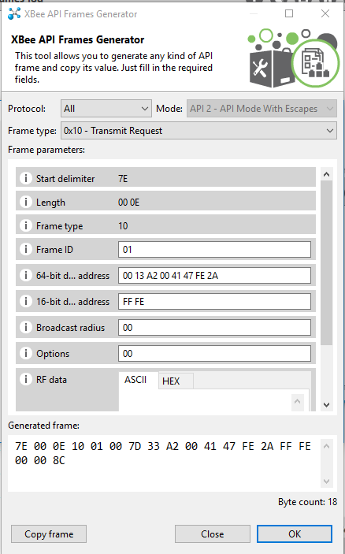
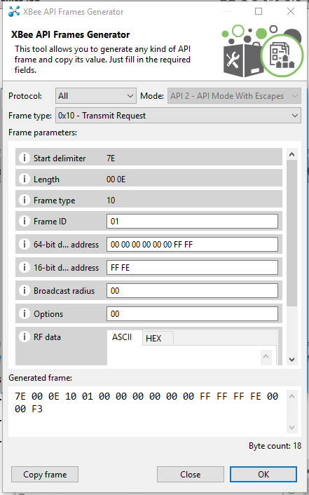
DigiMesh Network Setup
UNICAST
Set 64 bit Address as the destination Address
BROADCAST
Set 64 bit Address as 000000000000FFFF

Slide 8
DigiMesh Network Setup
BROADCAST TRANSMISSION:
In Broadcast Transmission, the same data is transmitted to all the nodes present in the network
This transmission goes throughout the network, so that data is received by all the nodes connected in the network
To make this possible, all the receiving nodes and the starting node will transmit the data to the number of times mentioned by the Broadcast Multi-Transmit (MT) setting (the default value of MT is 3).

Slide 9
DigiMesh Network Setup
UNICAST TRANSMISSION:
In Unicast Transmission, the transmission of data to a single node in a network is identified by a unique 64-bit address
The destination address can be an immediate neighbor or can be several hops away
When DigiMesh unicast transmission, a reliable delivery of data can be accomplished with the help of reties and acknowledgements:
For transmission between adjacent nodes, MAC retries/acknowledgement is used
For an entire route, network retries/acknowledgement is used

Slide 10
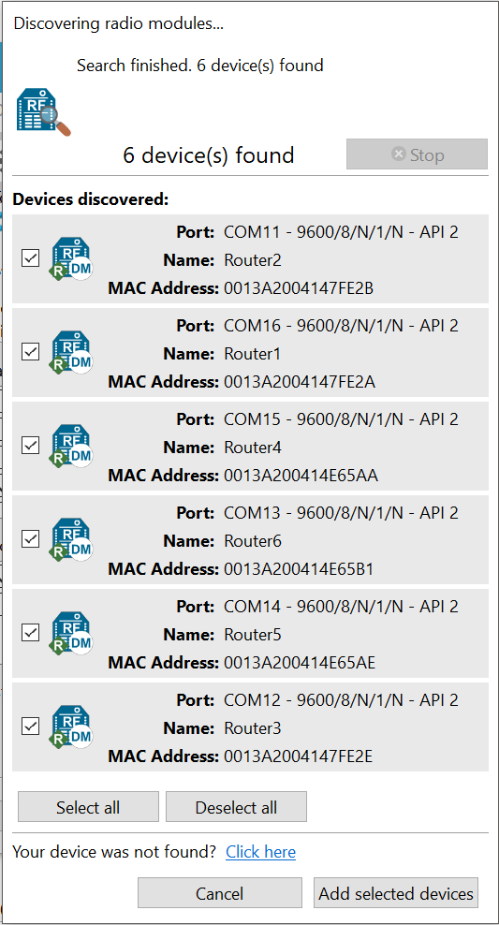
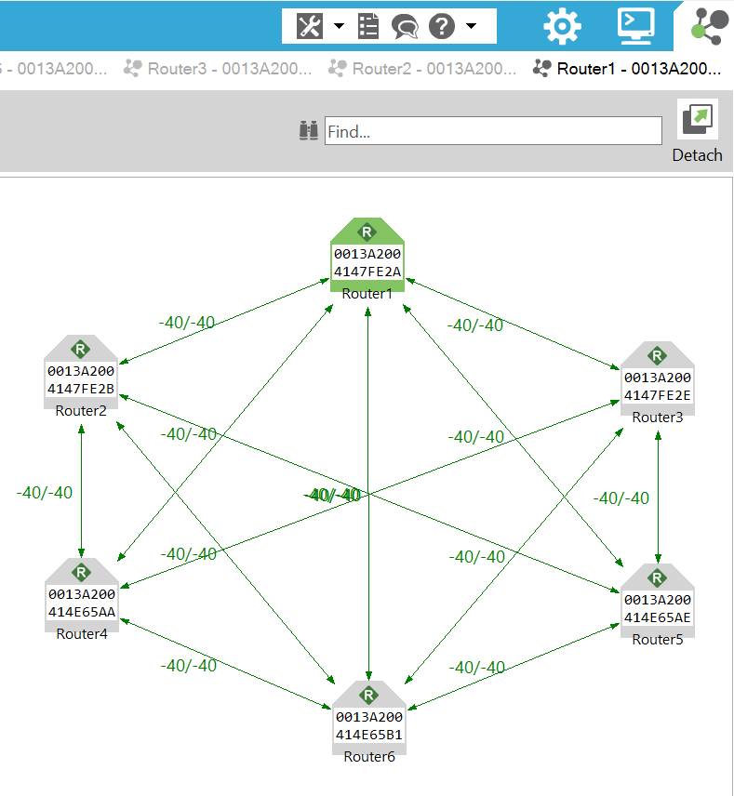
DigiMesh Network Setup
We can discover the devices in XCTU
Once we set all the parameters required to make them communicate, we can see the network in the Network Mode

Slide 11
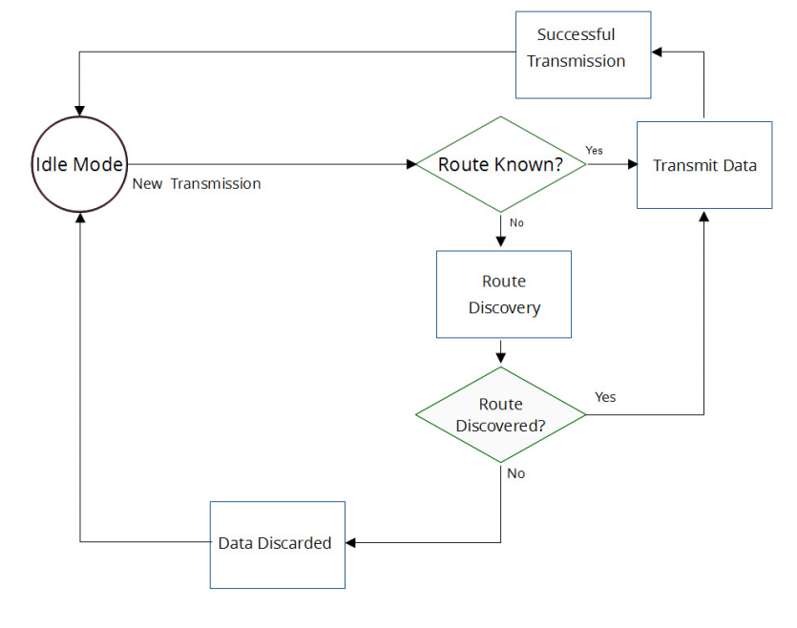
Wireless Data Transmission
Transmit Mode Sequence:
If Route is known, the data packet is transmitted directly
If Route is not known, movement to Route Discovery will happen so that we can establish a path to the destination node
If no route is possible to reach the destination, the data packet is discarded and go back to Idle Mode
Route discovery is done only once per packet

Slide 12
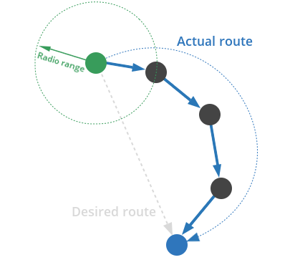
Routing
Many a times, a direct Route is not possible because either they are placed very far apart from each other or the environment is making difficulty in connecting. To solve this, we use Bridge connection to make the communication possible
In bridge connection, the node is placed within the range of the starting node to pass the data, which then connected to another node to pass the data. This process continues until the data is reached to the final destination.
There are four types of Routing:
Route Discovery
Trace Routing
Aggregate Routes
Disable Routing

Slide 13
Routing
Route Discovery
This process works on Ad-hoc On Demand Distance Vector Routing (AODV) protocol
It uses the Routing tables in each node to store the next hop for the destination node
When choosing a discovery route from node A to node B, a broadcast is done from node A and if no direct route is found, the route is chosen by the intermediate nodes to reach node B.
Once the route is discovered till node B, the reply is sent through a unicast route discovered from node A to node B
Since broadcast is done from node A to node B multiple replies may be received by node A, it select the route with the best round trip time and use that route to node B for every next transmission
Trace Routing
While sending a unicast data with Trace Route enabled, each intermediate node send a route information packet (0x8D) back along the route to the originating node. This information packet contains:
Source and destination address of the unicast transmission
The address of the next hop in the route to the destination node
The address of the node generates the route information packet
Notes:
Aggregate Route: Sometimes the data needs to be transmitted to a center aggregate node which a create an overhead in a DigiMesh network resulting in poor performance. To reduce this, use AG command to build an automatic route to the aggregate node.
Disable Routing: It shuts off the routing to reduce the network traffic.

Slide 14
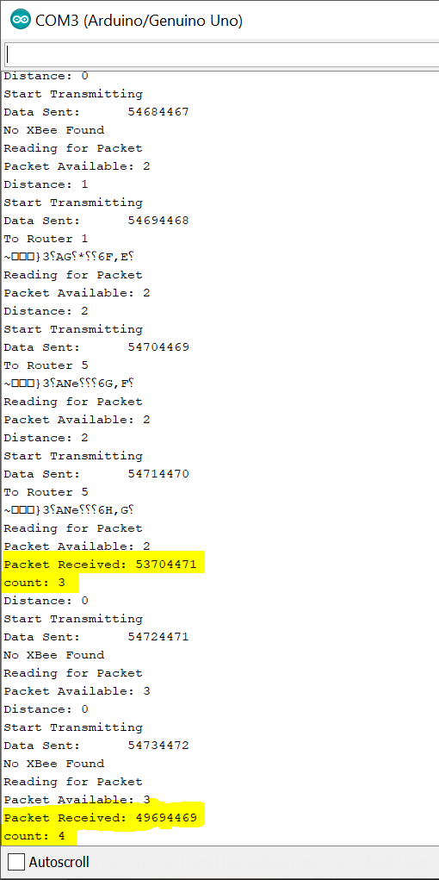
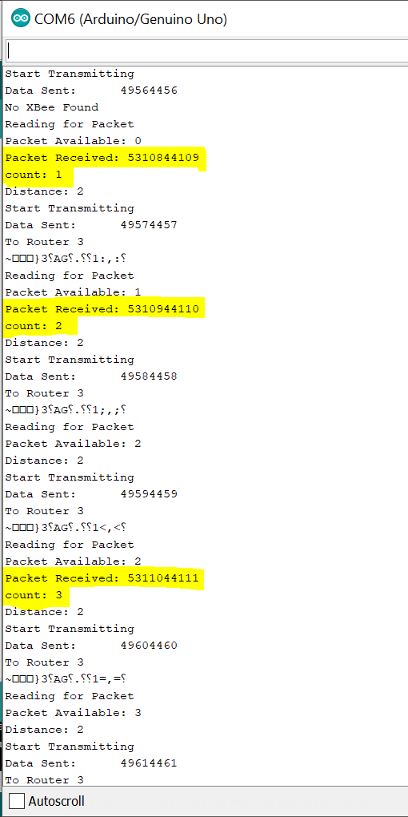
XBee & Arduino Communication
XBee-Arduino Library
Download the XBee-Arduino Library either from manage libraries in the Arduino IDE or by going to https://github.com/andrewrapp/xbee-Arduino
Among Series 1 and Series 2, we use Series 2 examples given after downloading this library. For working on XBee 900HP DigiMesh Module
TRANSMITTER
RECEIVER

Slide 15
References
Datasheet of XBee 900HP DigiMesh Kit: https://www.digi.com/resources/documentation/digidocs/pdfs/90002173.pdf
01
GitHub page of Andrew Rapp: https://github.com/andrewrapp/xbee-Arduino
02
Building Wireless Sensor Network using Arduino – Dr. Matthijs Kooijman
03

Slide 16

Questions?

